Slide 1
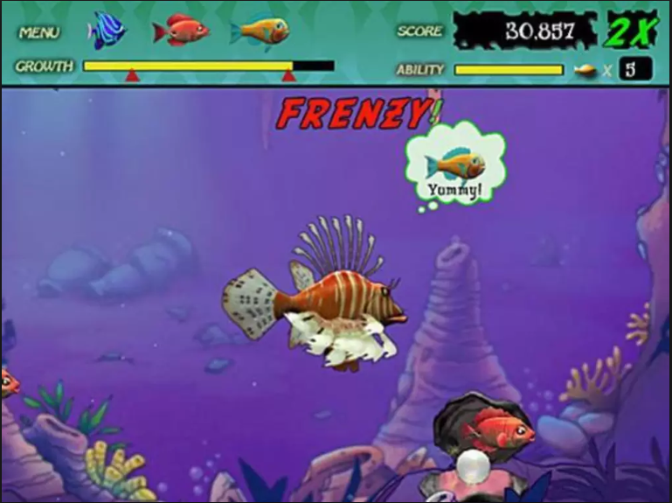
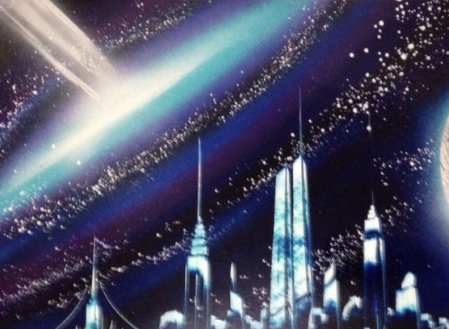


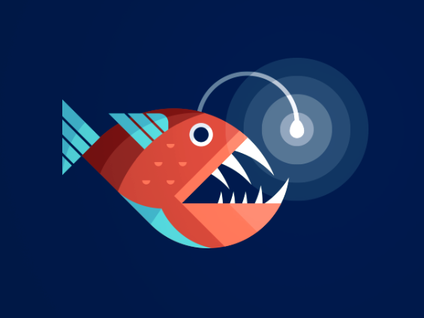
Angler in Space
Game Design Doc
Gameplay Summary
Game Identity/Mantra
You are a Space Angler fish who’s vision depends on the amount of Energy You Have
Design Pillars
Dangerous in Space
Energy
Vision
Similar to Feeding frenzy your goal is to consume available food to keep your energy up which allows you to see more of space. If you run out of energy you will perish in darkness. To gain the most energy possible you want to eat only organic food sources, this means playing dead for space ships so they send astronauts out to investigate resulting in a delicious snack.
Genre
Action
Platform
PC
Interface
Target Audience
Judges, Game Jammers, Friends,
Art Style
Clean Vectored artwork with bold Colours
Players vision cone depends on the amount of food they have eaten. Their energy level is also displayed in a meter on the screen. The player stays in the middle section of the screen that will display more in front of them when they start moving.
Musical Style
5/4 Clave or 5/4 timing
Examples:
Sungazer’s Ether by Adam Neely
Hollow Bastion from Kingdom Hearts
Mission Impossible
Take 5 by Dave Brubeck
Something Spacey
Development Roadmap
Milestone 1 | Base Systems Functioning | SAT 10AM
Milestone 2 | First Prototype with all systems | Sat 2pm
Milestone 3 | Revisions of systems and implementation of new systems | Sun 10AM
Milestone 4 | Final Game | Sun 2Pm
Release |  | Sun 4Pm
Features
Swimming Through Space
Vision based on Energy Levels
Different forms of replenishing Energy

